Slide 1
Management in chaos
Ron Shachar

Slide 2
We live in an era that is radically different from anything that we have ever seen in human history

Slide 3
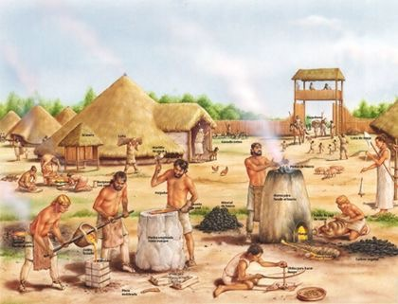
38

Slide 4
35

Slide 5
38

Slide 6
40

Slide 7
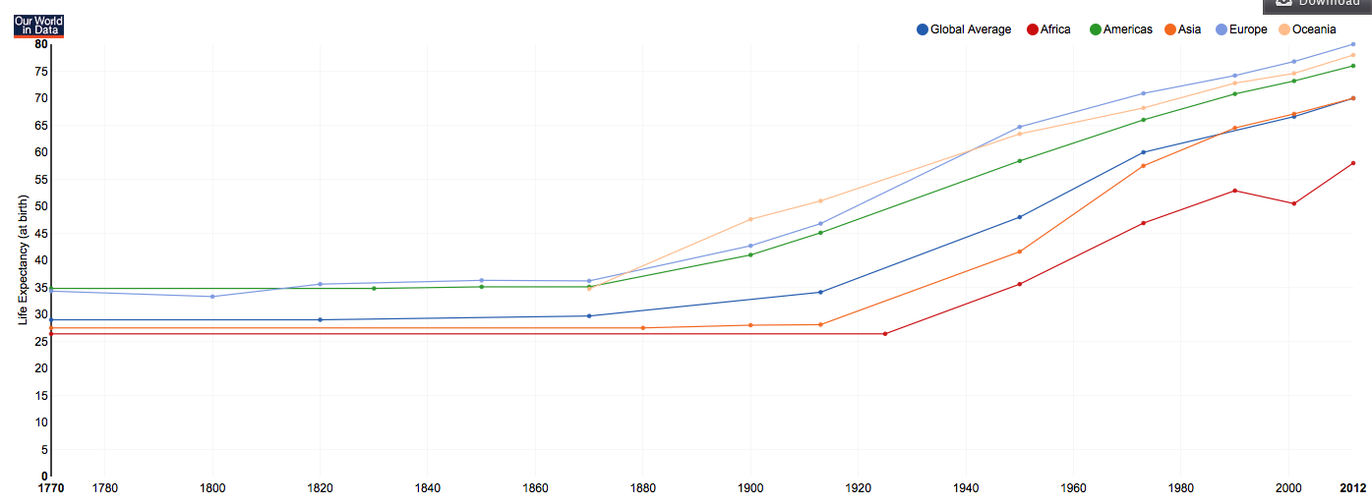

Slide 8
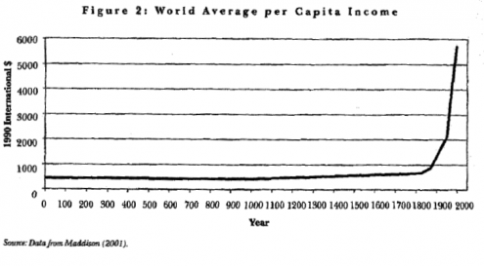

Slide 9
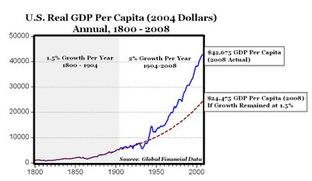

Slide 12
Companies

Slide 17
Managers

Slide 21
Data

Slide 23
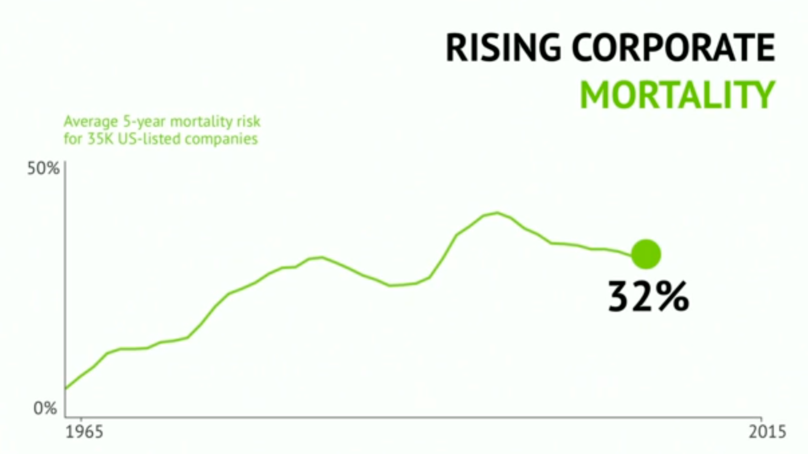

Slide 24
Fortune 500 firms in 1955 vs. 2014
89% are gone
???

Slide 25
Bloody

Slide 27
Find a bright spot and clone it

Slide 30
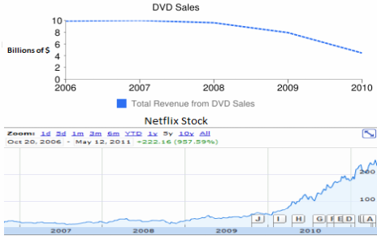

Slide 40
Thanks!

